Slide 1
PROJECT REPORT ON FLIGHT PRICE PREDICTION USING MACHINE LEARNING TECHNIQUES
AUTHOR: MS. YASHSHREE BAWIKSAR

Slide 2
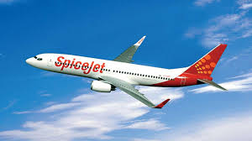
FLIGHT PRICE PREDICTION
Customers are seeking to get the lowest price for their ticket, while airline companies are trying to keep their overall revenue as high as possible and maximize their profit.
India is the third-biggest avionics showcase in 2020 and the biggest by 2030.
From the customer point of view, determining the minimum price or the best time to buy a ticket is the key issue. The conception of ‘‘tickets bought in advance are cheaper” is no longer working (William Groves and Maria Gini, 2013)

Slide 3
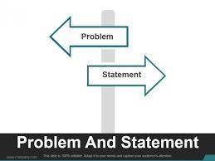
PROBLEM STATMENT
Anyone who has booked a flight ticket knows how unexpectedly the prices vary. The cheapest available ticket on a given flight gets more and less expensive over time. This usually happens as an attempt to maximize revenue based on –
Time of purchase patterns (making sure last-minute purchases are expensive)
Keeping the flight as full as they want it (raising prices on a flight which is filling up in order to reduce sales and hold back inventory for those expensive last-minute expensive purchases)
So, we have to work on a project where we have collect data of flight fares with other features and work to make a model to predict fares of flights.

Slide 4

DATASET INFORMATION
Dataset is Scrap from www.yatra.com
Selenium web driver is used to Scrap data of around 2671 flights data
Raw data in excel file contain 10011 rows and 19 feature .
Dataset contain some errors, so data cleaning operation was performed.
Data integrity check is perform for missing values, duplicate data, data error.

Slide 5
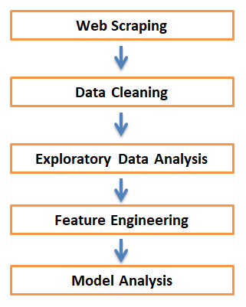
OBJECTIVE
To scrap flight data of at least 2671 cars from yatra.com
To Analyze data to gain key insights about current flight price market
To build Machine Learning model to predict price of flight data

Slide 6
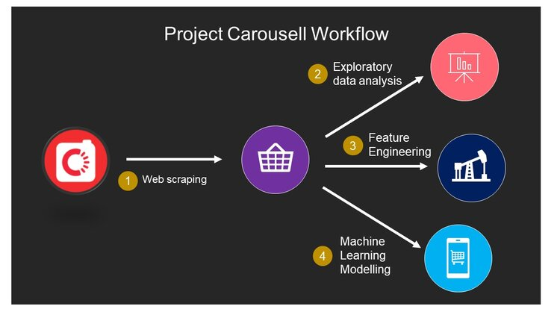
METHODOLOGY OF PROJECT
Phase 1 Web Scraping of Used Car Data from www.cardheko.com
Phase 2 Data cleaning, Data preprocessing on Raw data to create error-free, clean dataset.
Phase 3 EDA to gain key insight about used car market
Phase 4 Building Regression based Machine Learning price predication model

Slide 7
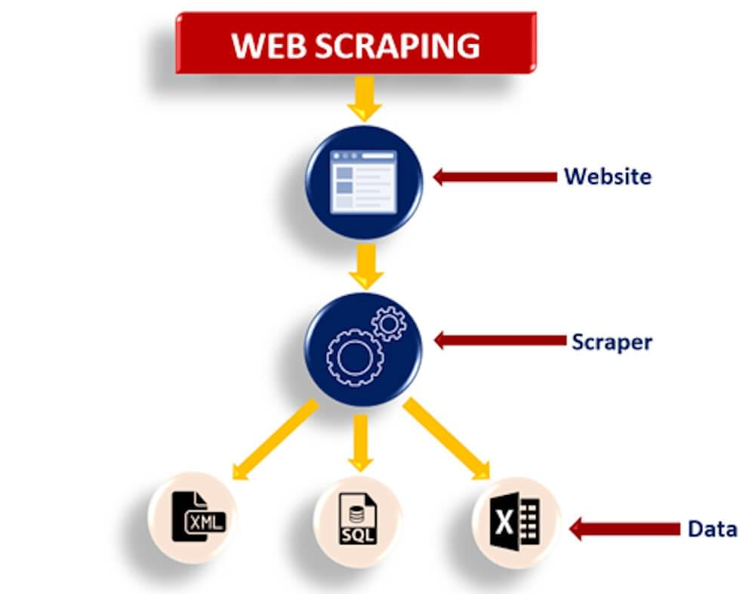
WEB SCRAPING STRATEGY
Phase 1 Web Scraping Strategy employed in this project as follow:
Selenium will be used for web scraping data from yatra.com
The 1st phase started to scrap the flight data for Mumbai to delhi location for various dates and class of flights.
After scarping the data stored into separate date wise CSV file, once all scarping done , club all csv file into one data frame using glob command.

Slide 8
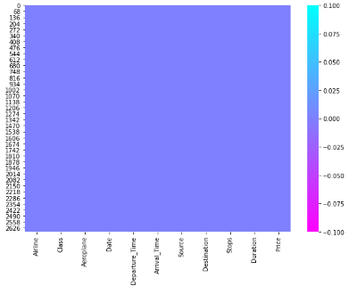
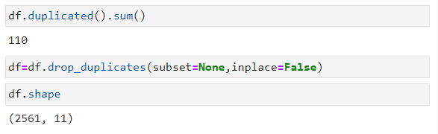
DATA INTEGRITY CHECK
Here check for Duplicated values if available in the dataset and drop it to avoid further prediction result
Above heatmap shows us that there is no missing value available in the dataset

Slide 9
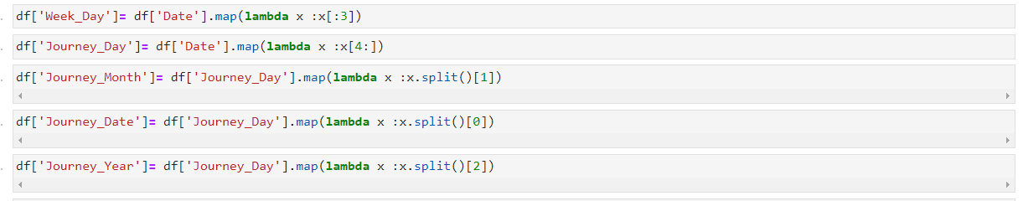
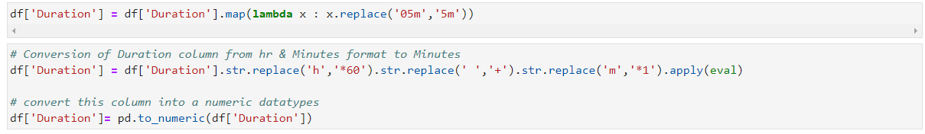
hW
FEATURE ENGINEERING
Here we have create new feature for day and date from date feature
Also we have done conversion of hour and minute time duration into minutes to get clear idea while dealing with data

Slide 10
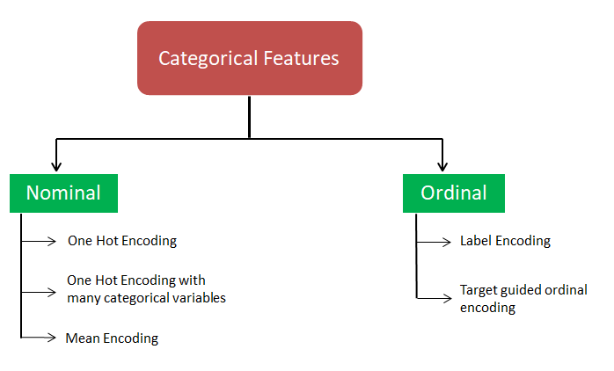
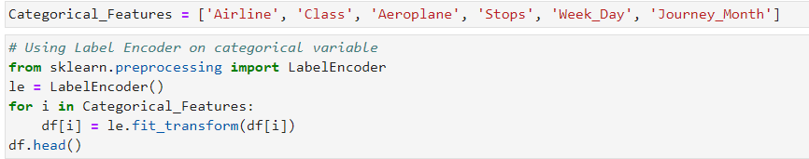
LABEL ENCODING OF CATEGORICAL DATA
Categorical features are transform using label encoding.

Slide 11
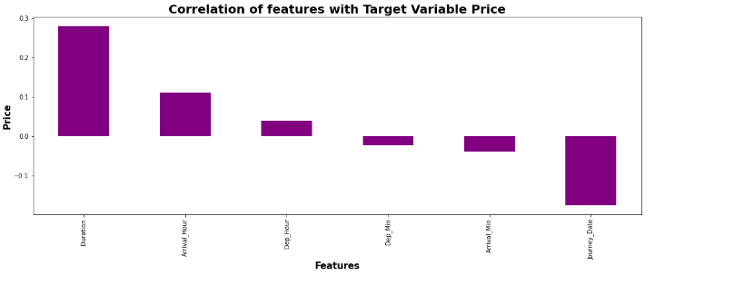
Data Inputs- Logic- Output Relationships
We can see most of feature are either poorly or moderately correlated with target variable Price.

Slide 12
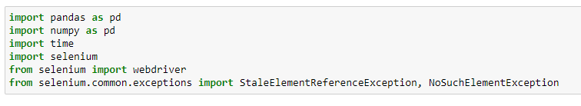
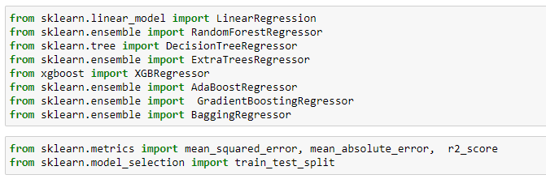
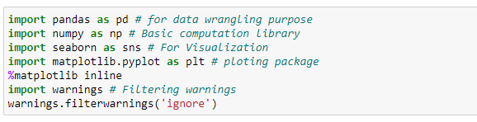
PYTHON LIBRARIES USED IN THIS PROJECT
Different libraries used for web scraping
Machine Learning model building libraries
Visualisation libraries used

Slide 13

Exploratory Data Analysis
Let’s Start’s to Exploring the data to get some insights

Slide 14
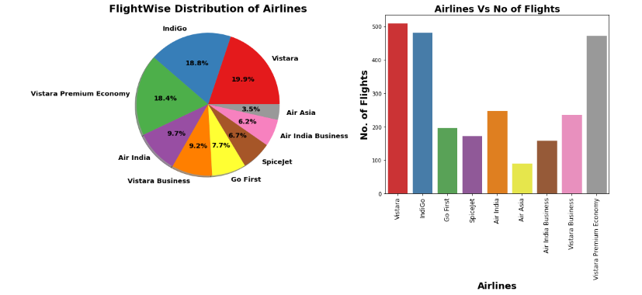
AIRLINE TYPES
We can see maximum number of flights run by Vistara Premium Economy
while minimum Flights run by SpiceJet.
Around 15% of flights of Business Class.

Slide 15
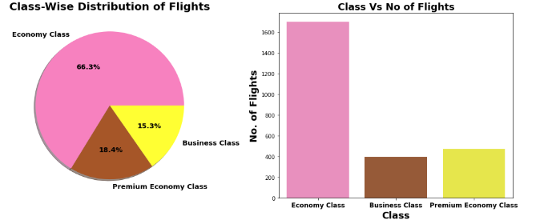
CLASS WISE DISTRIBUTION OF FLIGHTS
66.3% flights are of Economy class, as they are low cost of flight & most of people prefer it.
There are more Premium Economy flights than business class flights. It not because Business class is less costly than Premium Economy class.

Slide 16
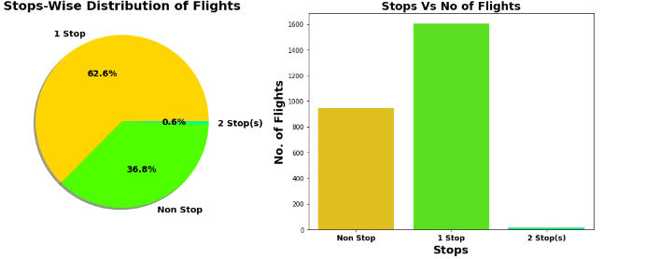
STOP WISE DISTRIBUTION
62.6% flights take single stop in there way from New Delhi to Mumbai. It is also possible that these flights may have high flight duration compare to Non-stop Flight.
36.8% of flights do not have any stop in their route.

Slide 17
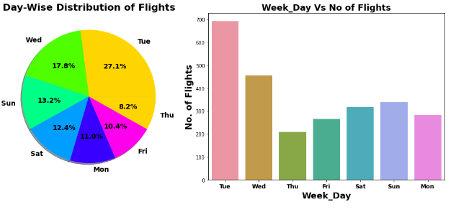
DAY WISE DISTRIBUTION
On Tuesday Maximum flights run while on Thursday minimum flights run
It will be interesting to investigate variation of fare as per different week days

Slide 18
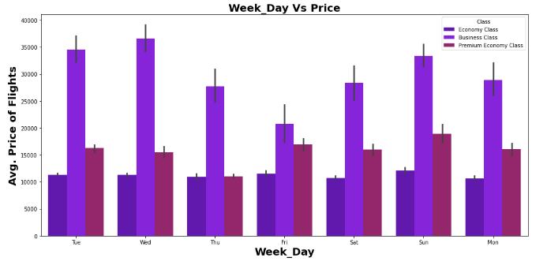
WEEK DAY VS PRICE
Maximum Avg. Fare for Business Flights is on Wednesday while minimum Avg. Fare for Business flights on Thursday.
For Economy Flights & Premium Economy Flights: Minimum Avg. Fare on Friday.
For Economy Flights & Premium Economy Flights: Maximum Avg. Fare on Monday.

Slide 19
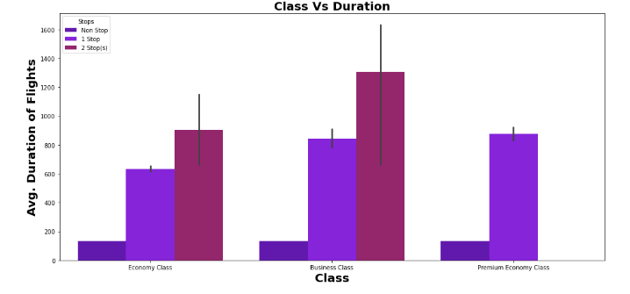
CLASS VS DURATION
PRICE VS CAR AGE
As Number of Stops increase the duration of flights increases.
As per Class of flight Maximum Avg. Duration of flight is for Business class.

Slide 20
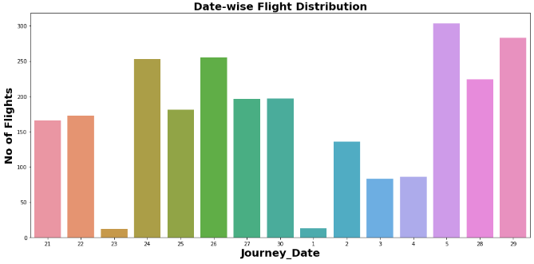
DATE WISE FLIGHT DISTRIBUTION
Maximum flights schedule on 5th July 2022
Minimum flights schedule on 23 June 2022.

Slide 21
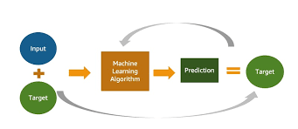
MACHINE LEARNING MODEL BUILDING

Slide 22
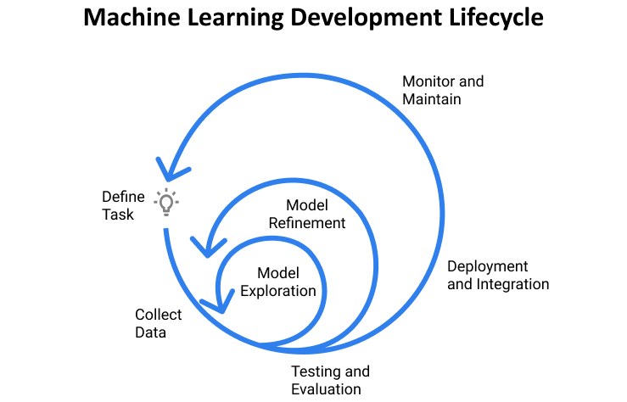
MACHINE LEARNING MODEL BUILDING
Objective is to predict price of used car . It can be solve by application of regression ML algorithm. Different Regression algorithm used to train model, in order build ML model with maximum R2 Score.
Machine learning classification algorithms used in this project are –
Random Forest Regressor
Decision Tree Regressor
XGB Regressor
Extra Tree Regressor
Gradient Descent Regressor
Linear Regression

Slide 23
ML MODEL EVALUATION MATRIX
Algorithm | R2 Score | CV Score
Random Forest Regressor | 89.94 | 0.63
XGB Regressor | 89.31 | 0.62
Linear Regression | 49.07 | 0.63
Decision Tree Regressor | 85.42 | 0.53
Extra Tree Regressor | 84.78 | 0.66
Gradient Boost Regressor | 88.80 | 0.67
Random Forest Regressor Parameter Tuned Final Model | 90.93 | 0.82

Slide 24
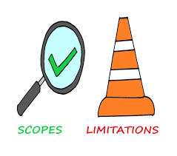
LIMITATIONS & SCOPE FOR FUTURE OF THIS WORK
Around data for more than 2671 flight scrap from yatra.com
We can scrap more data from different online platform like gobibo, MakeMyTrip etc More data obviously means more accurate predication.
Here we Scrap almost 12 features. We can include more feature for more location in future to get more clear insight about the price prediction of flight

Slide 25


